Slide 1
INTRODUCTION TO SOFTWARE
ENGINEERING

Slide 2
Evaluation Guidelines
Tentative
ISA -1 & ISA -2 – CBT 35 Marks
Case Studies (and Quiz?) : 15 Marks
ESA- : 50 marks (100 marks paper scaled to 50)

Slide 3

Context of Software Engineering

Slide 4
Objectives for this capsule
Why Software Engineering
What is Software
What are Software products
What is Engineering
What is Software Engineering
Contrasting Computer Science and Software Engineering

Slide 5

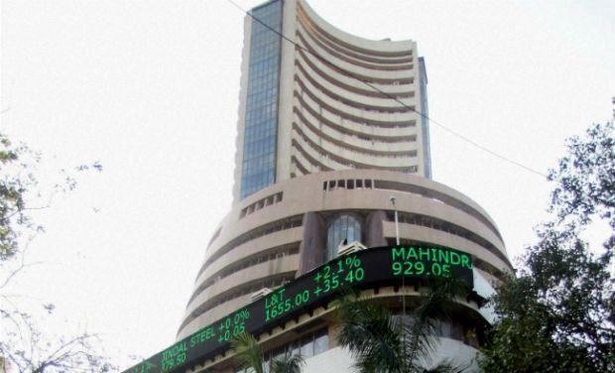


Look at the Pictures
Amazon.com

Slide 6
What’s expected from these
Machine which flies
Supports going to a specified place
Carries people and goods
Reliably functions
Market System supporting buying and selling of stocks/bonds/ securities
Supports buyers and sellers to be local/remote for all transactions
Regulation, Data Integrity, Security

Slide 7
What’s expected from these
System to play a video game for entertainment and competition
Supports individuals and groups
Runs on dedicated or general purpose systems
Supports various levels of skills and complexity
Amazon.com
Supports a market place featured around a web site
Will have number of upgrades and revisions

Slide 8
What do they have in common
Code
(and lots of It)

Slide 9
Looking at it in more detail
A Boeing 747 has more lines of code than the parts of the aeroplane including nuts and bolts
~ 5 Million lines of Code
Most Games have
~ 6 Million or more lines of code
(and this has to be done on different systems and different OSs etc.)

Slide 10
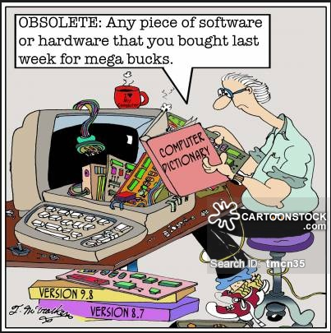
Diminishing value
… has to be dealt with

Slide 11
Impact?
In an environment like Amazon, say if one small upgrade had a problem and caused a 90 min outage.
Can you foresee the impact due to this outage?
– Loss 2.8M$ revenue
– Loss of customers
All of these have to be functioning in a user friendly way
And the expectation is that you do not have errors
- This has to be factored in
- These also need to be factored in

Slide 12
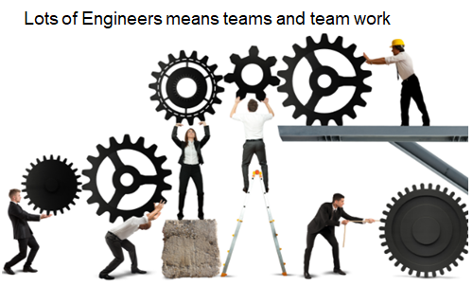


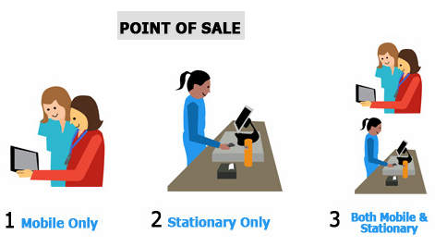

Leading to
Need for interacting with customers and other stake holders on what is needed
Need for understanding who and how is this going to be used
Need Experts in different domains to support this (Cross domain)
Need for good Planning
Need for good Teamwork
Need to have an ability to scale/support
Lets assume an Engineer can code 1 LOC a min
Then
1 LOC/min * 60 min/hr = 60 LOC/hr
Say for 40 hrs/Wk, 60*40 = 2400 LOCs/week/SE
-> 2400 LOC/week * (~)50 = 1,20,000 LOCs/Yr/SE
So lots of engineers will need to be working for long period of time

Slide 13
Given all of this context
If we look at some of the definitions involved
Software can be collection of executable computer programs (code), their configuration files and associated libraries and their documentations serving a computational purpose.
Software Product is Software when made for a specific or specific group of requirements
Software can include prefixes as Generic, Custom, System and Application
Engineering is all about acquiring and using well defined scientific principles and systematic methods for developing products, with economic sense, social perspective and practical considerations.
Involves making decisions or making choices given a context
Notes:
Software is not manufactured in the classical sense and does not wear out.
Software may be
Generic software - developed to be sold to a range of different customers e.g. PC software such as Excel or Word.
Custom software - developed for a single customer according to their specification.
System Software – designed to operate/manipulate hardware
Application software – developed to perform any task/function that benefits from computation
Programming Infrastructure software - Programs or applications that software developers use to create, debug, maintain, or otherwise support other programs and applications.
New software can be created by developing new programs, configuring generic software systems or reusing existing software or piecing together different software.

Slide 14
Software Engineering (SE)
Software Engineering is the systematic, disciplined, quantifiable approach towards the development, operation, and maintenance of software products and thus supports managing of complexity.
A software product developed using Software Engineering principles has a higher probability of being efficient and reliable.
Software Engineering principle drives usage of appropriate tools and techniques depending on the problem to be solved, while considering the constraints and resources available
Focuses more on techniques for developing and maintaining software that is correct from its inception
Notes:
Software engineering is beyond programs people write for something/hobby
Compexity : Changes from requirements (Customers, Business Environment and Business Processes are re-engineered), Changes from technology (tools, platforms, capabilities), Changes from people (interactions are complex and unpredictable) ..
Software engineering is an engineering discipline that is concerned with all aspects of software production.
Software engineering can also be looked at as the systematic and scientific approach to develop, operate, maintain and to retire the software product. Software product could be interpreted as software for a large/medium size complex problem.
Software engineering is imperative in a large project, though there are benefits and can/and is good to be used for the development of programs/small assignments.

Slide 15



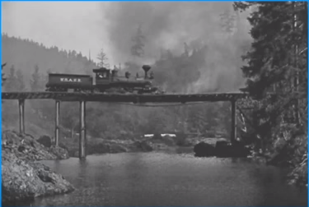
Is Computer Science == Software Engineering ?
Both of them go about solving problems using code but how they go about are different
E.g. A bridge collapse
Is it Scientists problem or an Eng. problem
Scientist build something to learn something new
Whereas
Engineer learns things to design and build quality products
Scientists want to achieve scientific breakthroughs
Whereas
Engineers want to avoid engineering failures

Slide 16

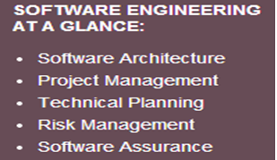
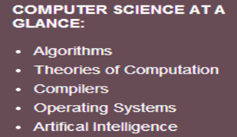
Is Computer Science == Software Engineering ?
Content differences:
Software engineering
Focuses on technical and managerial leadership for large and complex systems
It’s the foundation of enduring engineering principles which will support a lifetime of practice, amid emerging technologies.
Computer science
Focuses on foundations of computing including, algorithms, programming languages, theories of computing, artificial intelligence,.., and some hardware design.

Slide 17
Fundamental Drivers of Software Engineering (the Why’s)
Industrial Strength Software
Software is Expensive
Late and Unreliable
Can influence the life and death of a person
Heterogeneity
Diversity
Business and Social change
Security and Trust
Scale
Quality and Productivity
Consistency and Repeatability

Slide 18
Fundamental Drivers
Industrial Strength Software
needs to be
Operational : Functionality, Usability, Correctness …
Capable of being moved: Portability, Interoperability ..
Maintainable: Modularity, Maintainability, Scalability ..
have elaborate Documentation
absence/minimal number, of bugs is of primary importance
are Impactful to the business's leading to the need for strong processes for quality and resiliency

Slide 19
Fundamental Drivers
Software is Expensive
Software is labour intensive, Industrial-strength software is very expensive
Each line of code can cost from $5 to $35 and when calculated across the lifecycle could go as high as $400
Software also has loads of Maintenance and Rework which costs money
Maintenance could be corrective, adaptive or rework
Includes cost of Hardware-Software-Maintenance

Slide 20
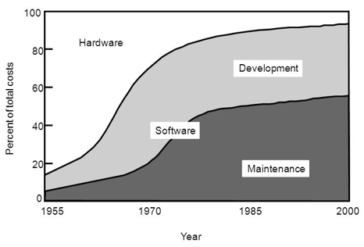
Relative distribution of software/hardware costs
Notes:
https://www.youtube.com/watch?v=H2tuKiiznsY&authuser=1

Slide 21
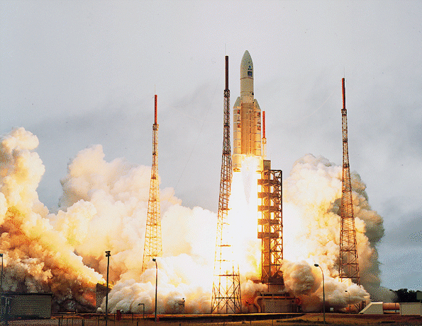

Fundamental Drivers
Late and Unreliable
Typically 35% of the computer based projects are runaway
70% of equipment failure in Defence is considered due to software
E.g. NASA Rocket Failure

Slide 22
ARIANE Flight 501
Disintegration after 39 sec
Caused by large correction for attitude deviation
Caused by wrong data being sent to On Board Computer
Caused by software exception in Inertial Reference System after 36 sec
Notes:
This was the maiden flight of the Ariane 5.
The Inertial Reference System determines the position of the rocket and its movements in space. It has its own computer, which computes angles and speeds based on information it gets from the ground station, lasers, etc. There are 2 IRS’s, which both failed.

Slide 23
The details
Overflow in conversion of variable BH from 64-bit floating point to 16-bit signed integer
Of 7 risky conversions, 4 were protected; BH was not
Reasoning: physically limited, or large margin of safety
In case of exception: report failure on data-bus and shut down
Notes:
BH - horizontal bias
Not all conversions were protected, for performance reasons

Slide 24
Possible explanations
Specification did not contain Ariane 5 trajectory data as a functional requirement
In tests, the SRI’s (components that measure altitude and movements of the launcher) were simulated by software modules
Inadequate testing
Improper reuse
Wrong design philosophy
Further Information if interested
IEEE Computer, jan. 1997, p. 129-130
http://www.cs.vu.nl/~hans/ariane5report.html
If a component works perfectly well in one environment, it doesn’t necessarily do so in another
Ariane 5 was much faster than Ariane 4, and horizontal velocity builds up more rapidly
⇒ excessive values for parameter in question
Wish for quick alignment after hold in shutdown
⇒ this software runs for a while after lift-off. It doesn’t have any purpose for the Ariane 5, but was still kept
If something breaks down, such is caused by a random hardware failure
Action: shut down that part
There is no provision for design errors
Notes:
In a sense, all these explanations are true
This shows the complexity of issues, and the trade-offs involved

Slide 25
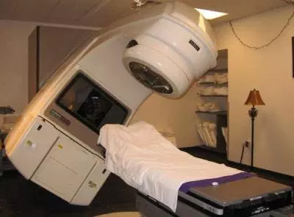
Fundamental Drivers
Can influence the life and death of a person
Therac 25 – (Radiation Therapy M/C) 6 People died due to over exposure to radiation – One cause a S/W bug
Heterogeneity
Systems are required to operate as distributed systems across networks that include different types of computer & mobile devices.
Diversity
There are many different types of software systems necessitating different techniques, methods and tools.
Business and Social change
Changes are happening quickly with economies & organizations getting more global, and availability of new technologies. Organizations need to have the ability to change their existing software to rapidly develop new S/W

Slide 26
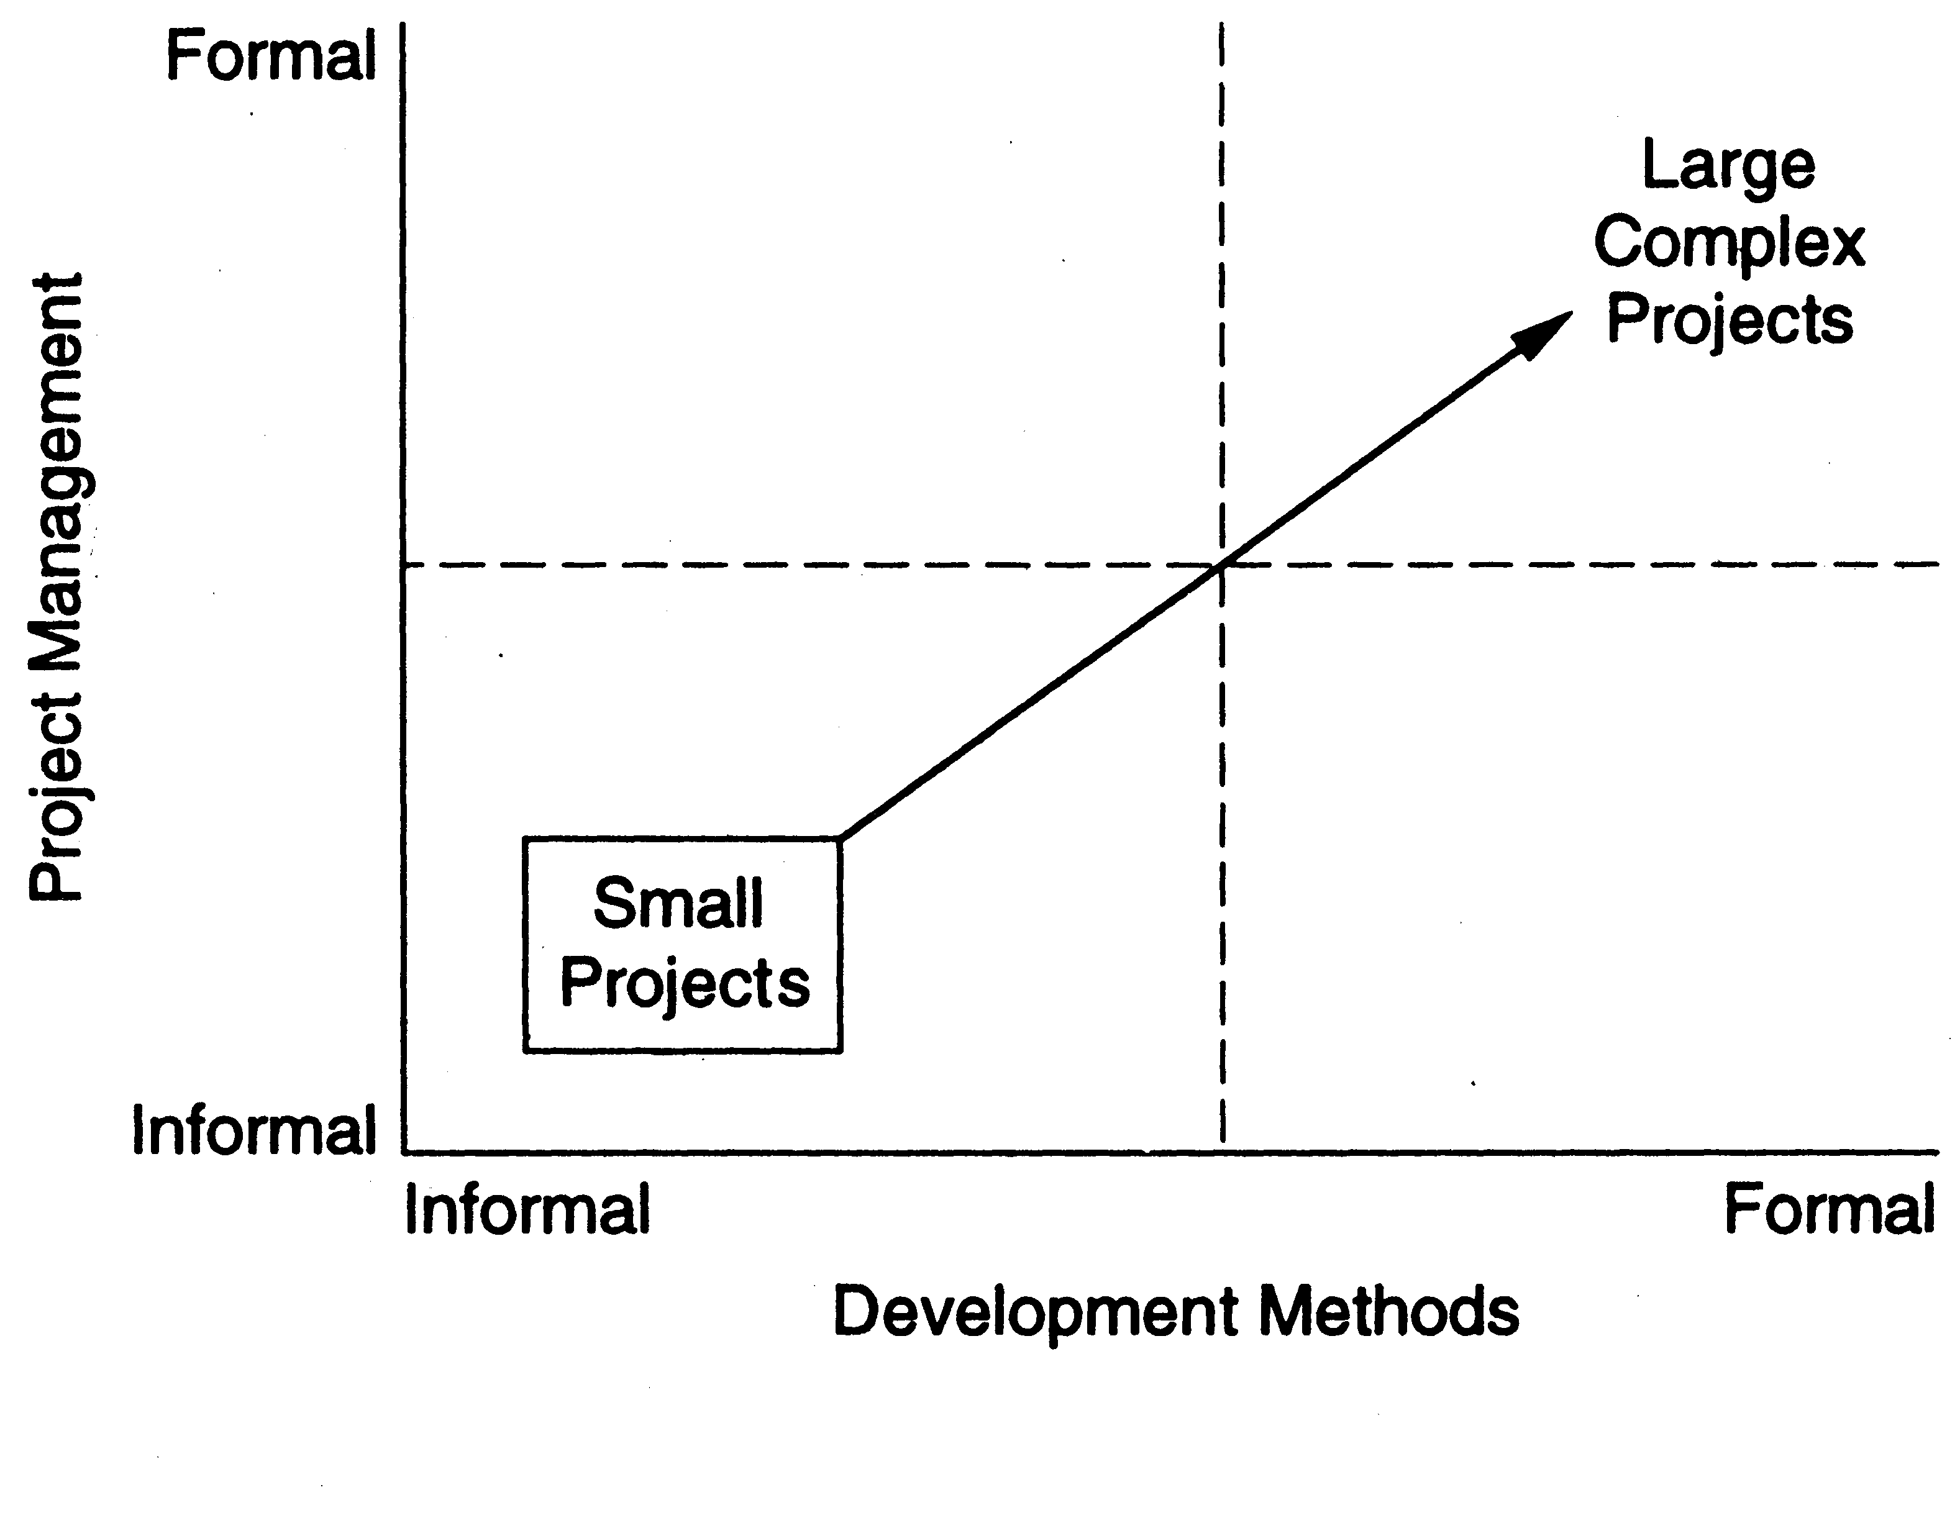
Fundamental Drivers
Security and Trust
SW is intertwined with all aspects of our lives, it is essential that we can trust that software
Scale
Processes and methodologies needs to scale easily with size
Quality and Productivity
Software quality which could be looked at as FLURPS+(efficiency or Maintainability) + Portability
Consistency and Repeatability
Notes:
Functionality Localizability Usability Reliability Performance Supportability
Questions on relevance of software engineering practice
Increasing Open Source Movement leading to questions on some of the engineering processes

Slide 27
Summarily Software Engineering is for
Development of BIG programs
Mastering complexity of these Large programs/Systems
Development of Software that is Evolving
Efficient development
Supporting large teams, teamwork and global development
Ensuring a process through which software being developed, supports the users effectively
Ensuring that the right choices or decisions are made while working under constraints or supports the balancing act
Ensuring the needs of visibility and continuity
Notes:
- Space Shuttle software: 40 million lines of code
- complexity often is not “mathematical” complexity, but caused by the myriad of details to be handled
- reality changes, so the software has to change as well (e.g. salary administration and changing tax regulations)
- software costs a tremendous amount of money (it is very labor intensive)
- OS 360 cost 5000 person years (so you need rules and regulations - hence process models)
- so user involvement
- software engineers tend to have little knowledge of the application domain

Slide 28
House Construction Lifecycle
Could you think of the steps involved in the construction of a House
Notes:
Create a Budget for Building Your Home. ...
Buy Some Land. ...
Plan Your Home's Layout. ...
Find a Builder and an Architect. ...
Floor Plan.
Elevation 3-D.
Structure Drawings.
Working Drawings.
Electrical layout.
Plumbing layout.
Drainage Drawings.

Slide 29
House Construction Lifecycle
You realize that you have the means or you have a want or you want to save money on rentals and think you want to build your own house
Collect information on the where you want to build it and the cost of site, cost of building, commute, ambience, green, investment. - distance to family/friends, etc.
Analyse whether it makes financial sense – rental/loan repayment/interest which can be earned ..
Hire a broker .. look at sites and select a site and buy a Site
Hire an Architect to evolve an conversion/rendering of your dream to an implementable Plan.
Meetings between you and the Architect to describe what you want
Includes what you want it to look like
Features to be included
Architect draws up the rendering/models/drawings - elevation/plans
Interactions between you and architect and the requirements are finalized post relooking at renderings/models/drawings and get regulatory approvals
Time plan with what are different specializations needed and dependencies are identified .. Scope – Schedule - Resources
Decision Made

Slide 30
House Construction Lifecycle
Architect – and you together identify and hire a contractor to build a house .. additional specializations like leads towards a structural engineer, plumbing, electrical, carpentry etc.
Architect provides different views and drawings/requirements for each of the person Electrical drawing, Plumbing drawing, Structural diagram etc.
Further discussions, changes and everyone agrees to the plans and parallelly contractor begins constructing the house
In between you would visit the site and indicate changes you would like .. Several changes and then house is constructed
There are different phases .. Columns, rest of Foundation, Walls, Roof, Plastering .. dependencies and implementation
Contractor believes its complete .. Has each of the things checked independently as a unit by the respective actors … electrician has checked wiring - points, plumber has checked for leakages … etc .. painter has done his parts etc.
Contractor (and maybe you too) look to see after all of them have completed (Integration and as complete function as a system) are there issues which are cropping up .. say wires showing up .. missing cable or network points or door being obstructed .. something not being able to be closed etc.
Before you move in, you go out to check several things (Switch too close to wardrobe and not easy to operate, Switch not next to the door etc.. ) (User acceptance testing) and then accept and do .. Grihapravesha ..
Initial hiccups when you would call the contractor A .. water not getting drained away .. and then you move in.
Now you are responsible for the house and you maintain the house later by calling the respective plumber etc.

Slide 31
House Construction Lifecycle
So we could describe this as
Initiation (budget, site, architect)
Initial requirements and feasibility
Crystallization of requirements, needs, wants working with architect
Need to consider the Social, economic and government regulations like offset .. Social expectations/constraints (.. Vaastu .. Agni.. Etc.)
Designing and Planning (plans, layouts, contractor, approvals)
Execution – Build, Monitor
Completion – testing and verification
Acceptance by you
Move in and fixing initial issues with modifications after the residents have moved in
Continuing maintenance by the residents of the house

Slide 32
House Construction Lifecycle
Few things to keep in context
You could get into the steps of constructing based on understanding the feasibility and decisioning to go ahead.
There could have been multiple rounds of discussions, validating your requirements, rendering/converting of your dream into a set of requirement which could be acted on.
Since there are number of stakeholders contributing to ensure that they all are working towards the same goal .. Lots of diagrams with different views details, designs, plans are done and shared [Documentation]
Give that everything is not easily visualizable, there may be changes, refinements which might need to be done during the construction of the house. Say like
Sky light or a anteroom etc
Cost escalations which may need to reduction of scope
Non-availability of some material leading to change in the plan etc

Slide 33
House Construction Lifecycle
You would definitely not want to finalize the plan and come back in the end to see the house .. You want to come in periodically see the progress which gives better understanding .. Which may need to make changes which needs to be done as and when and not waited till the end.
You would like to see the house after different phases of execution of the construction
Columns are constructed
Foundation is done
Lintel and after the walls and before the roof is done
Once after the supports are removed and the electrical and plumbing points are identified
Once carpentry is done before final painting …etc
Validation at different levels, Acceptance and Maintenance

Slide 34
A simplistic view of a Software Development Lifecycle
Project Management
problem
Elaborate the problem
requirements
req specification
Architect/design
Design document
implement
System which works
test
Functional system
maintenance

Slide 35
The software Lifecycle
Software Process (is also called Lifecycle or process model or lifecycle model)
Involves structured set (procedure/recipe) of activities (steps or phases mostly in a particular order) producing intermediate and final products
Every lifecycle step has a guiding principle that explain the goal of each phase. E.g. Requirements Engineering defines what the system should do.
Each of the steps in a phase can be a process by itself
Products are outcomes of executing a process (or a set of processes) on a project

Slide 36
The Software Lifecycle
Each of these activities/steps/phases produces an intended output of some kind, required to develop a software system and either implicitly/explicitly has :
Entry criteria : What conditions must be satisfied for initiating this phase
Task and its deliverable: What should to be done in this phase
Exit criteria : When can this phase be considered done successful
Who : Who is responsible
Dependencies : What are the dependencies for this phase ..etc.
Constraints : e.g. Schedule

Slide 37
The Software Process
Structure allows us to examine, understand, control and improve the activities in the process
There are other relevant processes like management process, configuration management process, change management process, Inspection process etc. which are part of the Software Development too

